Slide 1
ET0023 Operating Systems
7. Deadlocks

Slide 2
System Model
There are non-shared computer resources
May be more than one instance
E.g. Printers, Tape Drives, CD-ROMs
Processes need access to these resources
Acquire resource
If resource is available, access is granted
If not available, process is blocked
Use resource
Release resource
Undesirable scenario:
Process A acquires resource 1 and is waiting for resource 2
Process B acquires resource 2 and is waiting for resource 1
Deadlock!
Notes:
Computer systems are full of resources that can only be used by one process at a time. Common examples include printers, tape drivers and slots in the system’s internal tables.
Having two processes simultaneously writing to the printer leads to gibberish. Having two processes using the same file system table slot invariably will lead to a corrupted file system.
All operating systems have the ability to (temporarily) grant a process exclusive access to certain resources.

Slide 3
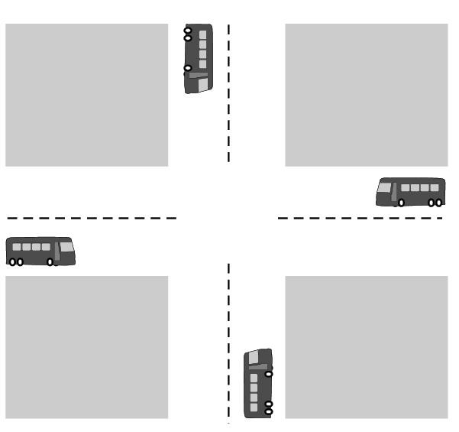
Deadlock!
When two or more processes are interacting, they can sometimes get themselves into a stalemate situation they cannot get out of.

Slide 4
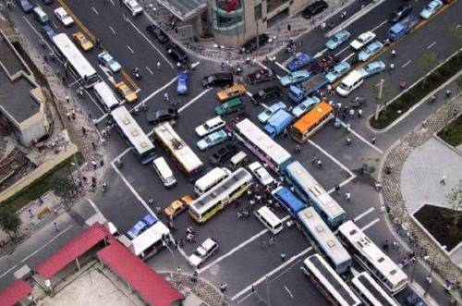
Deadlock!

Slide 5
Deadlock
A set of processes is in a deadlock state when every process in the set is waiting for an event that can be caused only by another process in the set.
Events:
Resource acquisition
Resource release
Resources can be physical or logical
Notes:
Deadlock occurs with two or more processes
Deadlock events are usually resource acquisition or release.
A major class of deadlocks involve resources.
Deadlock can occur on hardware resources or on software resources.

Slide 6
Simple Example:
A computer with a tape drive and a CD-recorder.
Two processes each need to burn a CD-ROM from data on a tape.
Process 1 requests and is granted the tape drive.
Next, process 2 requests and is granted the CD-recorder.
Process 1 requests the CD-recorder and is suspended until process 2 returns it.
Process 2 requests the tape drive and is also suspended because process 1 already has it.
Houston, we now have a deadlock!
Notes:
For many applications, a process needs exclusive access to several resources.
Eg. Two processes each required a scanner and CD recorder.
Process A request permission to use the scanner and is granted it.
Process B request permission to use the CD recorder and is granted it.
Now A asks for the CD recorder, but the request is denied until B releases it.
Unfortunately, B also asks for the scanner and is waiting for A to releases it.
Both processes are blocked and will remain so forever. The situation is called a deadlock.

Slide 7
Exclusive Resources
Physical | CPU, Memory, Printers, CD-ROM, Tape drives
Logical | OS Table, Data Tables, File systems
Problems:
Two processes simultaneously writing to the printer rubbish output.
Two processes using the same file system table slot corrupted file system
So, processes are temporarily granted exclusive access to resources (by the operating system).

Slide 8
Resource Usage
A sequence of events are required to use a resource
Process request the resource (from OS).
Request system call or open special file call.
Process use the resource.
Process release the resource (to OS).
Process must wait if request is denied
Requesting process may be blocked
May fail with error code
Notes:
If a resource is not available when it is requested, the requesting process is forced to wait.
In some OS, the process is automatically blocked when a resource request fails, and awakened when it becomes available.
In other OS, the resource request fails with an error code.

Slide 9
Resource Usage
Preemptable resources
Can be taken away from a process with no ill effects, eg CPU, memory
Non-preemptable resources
Will cause the process to fail if taken away e.g. CD-Writer, printer
Deadlocks involve only non-preemptable resources!
Notes:
Two types of resources: Preemptable and Non-preemptable resources.
A preemptable resource is one that can be taken away from the process owning it with no ill effects. Eg. Memory, CPU time.
A non-preemptable resource is one that cannot be taken away from its current owner without causing the computation to fail.
In general, deadlocks involve nonpreemptable resoruces.

Slide 10
Deadlocks
A group of processes is deadlocked if each process in the group is waiting for an event that only another process in the group can cause.
Usually the event is release of a currently held resource (owned by another process).
In a deadlock, none of the processes can:
Run
Release resources
Be awakened
All of them will be stuck waiting forever!
Notes:
Two processes wanted to print from a common memory location.
Process A requests permission to use the printer and is granted it.
Process B currently holding the memory is requesting permission to use the printer.
Note: it is possible to preempt (take away) the memory fro B by swapping it out and swapping A in.
Now A has both the memory and the printer. A can now run, print and then release the printer.
No deadlock occurs.
Sometimes processes need two or more resources. Resources can be acquired sequentially.

Slide 11
4 Conditions for Deadlock
Mutual exclusion condition
Each resource assigned to one process or is available
Hold and wait condition
Process holding resources can request additional resources
No preemption condition
Previously granted resources cannot be forcibly taken away
Circular wait condition
Must be circular chain of two or more processes
Each is waiting for resource held by next member of the chain

Slide 12
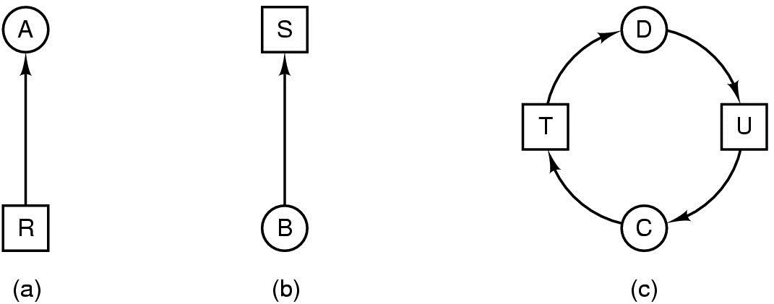
Deadlock Modelling
Modelled with directed resource graphs
Resource R is assigned to process A
Process B is requesting/waiting for resource S
Process C and D are in deadlock over resources T and U

Slide 13
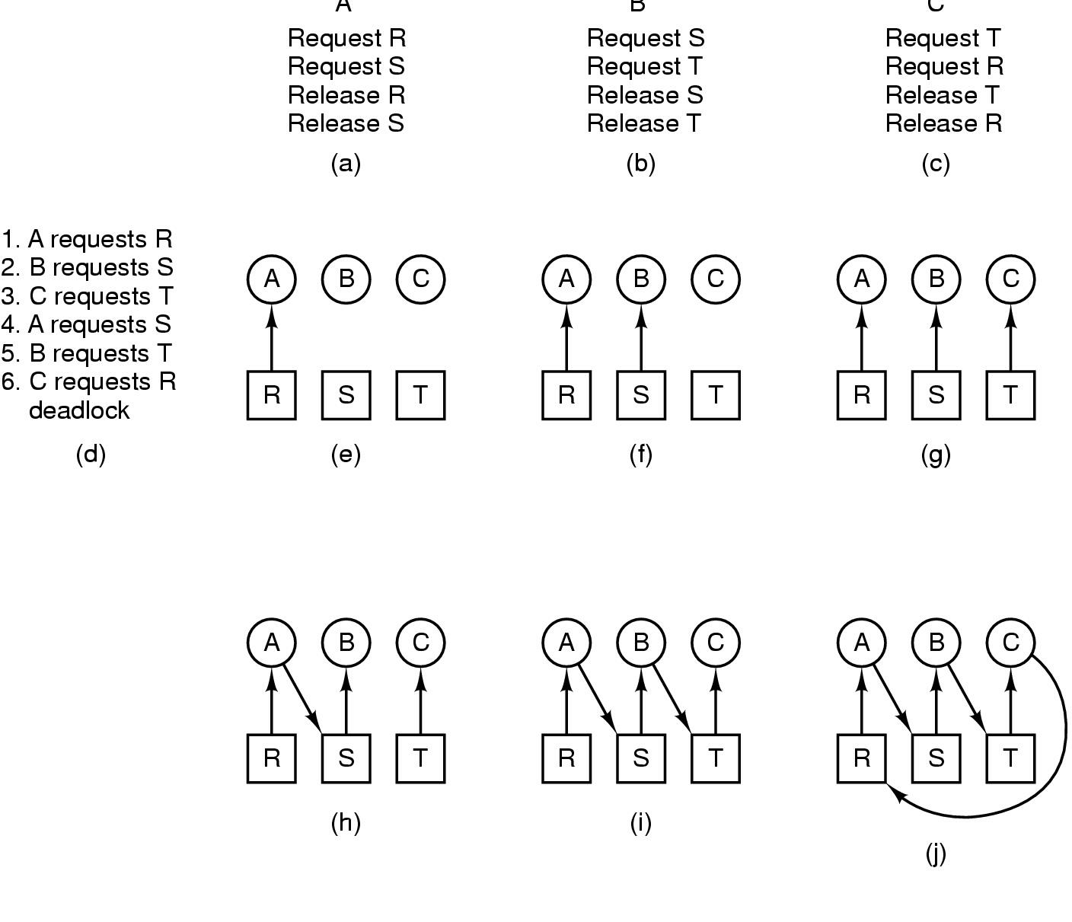
How Deadlock Occurs
Deadlock!

Slide 14
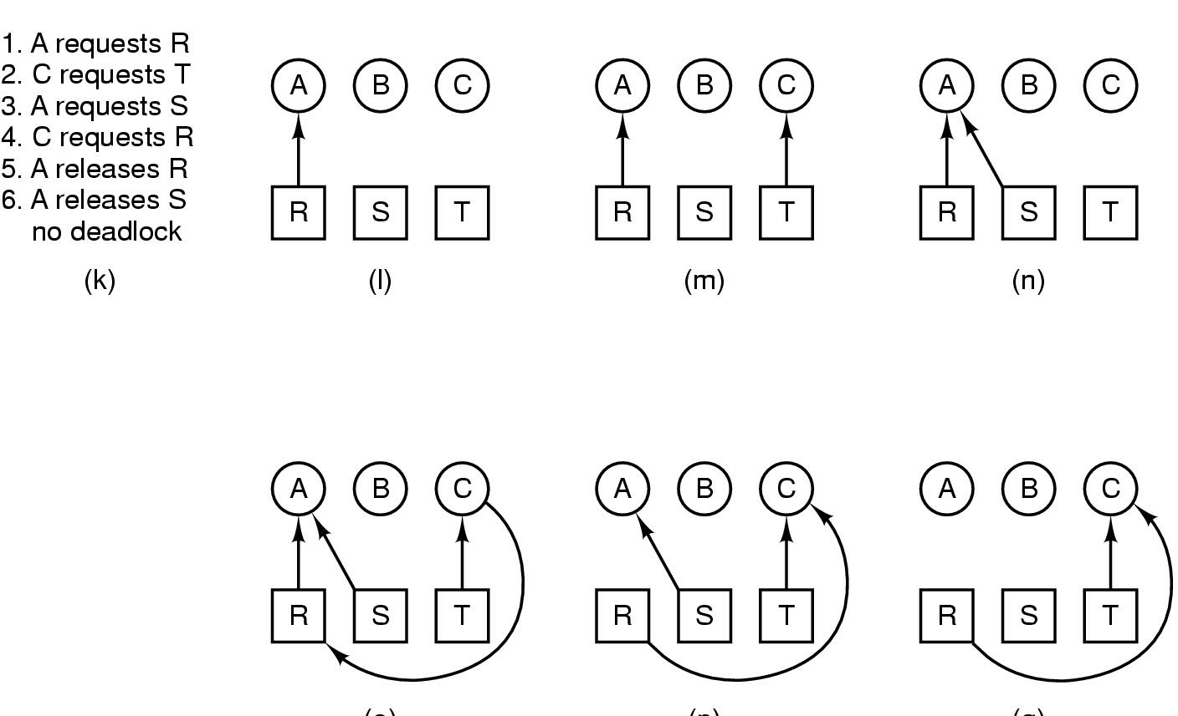
How Deadlocks can be Avoided
If granting a particular request might lead to a deadlock, the
OS can simply suspend the process without granting the
request (ie just not schedule the process) until it is safe.

Slide 15
How to handle Deadlocks
Just ignore the problem.
The Ostrich Algorithm
Detection and recovery.
Let deadlocks occur, detect them, and take action.
Dynamic avoidance by careful resource allocation.
Prevention by negating one of the four necessary conditions for deadlock.

Slide 16

The Ostrich Algorithm
Pretend there is no problem
Reasonable if:
Deadlocks occur very rarely
Cost of prevention is high
Linux and Windows takes this approach
Oracle database cannot!
It is a trade off between:
Convenience
Correctness

Slide 17
Detection and Recovery
OS does not attempt to prevent deadlocks from occurring.
OS tries to detect when deadlocks have happened. (every time a resource request is made)
Then it takes action to recover from the deadlock:
Recovery through preemption.
Recovery through rollback.
Recovery through killing processes.
Notes:
Recovery through preemption: In some cases, it may be possible to temporarily take a resource away from its current owner and give it to another process. In many cases, manual intervention may be required, especially in batch processing. It is highly dependent on the nature of the resource. Recovering this way is frequently difficult or impossible.
Recovery through rollback: If the system designers and machine operators know that deadlocks are likely, they can arrange to have processes states written to a file periodically.
Recovery through killing processes: Killing process in the cycle may break the deadlock. Alternately, killing an outside process will release requested resources.

Slide 18
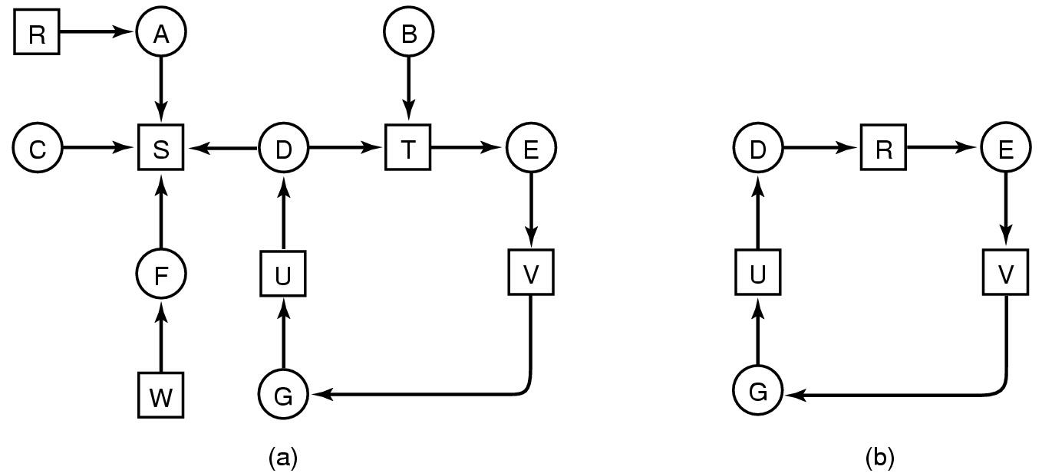
Detection with One Resource of Each Type
Note the resource ownership and requests
A cycle can be found within the graph, denoting deadlock

Slide 19
Deadlock Prevention (1)
Attacking the Mutual Exclusive Condition
Some devices can be spooled
E.g. Printers can only be accessed by the printer daemon
All process must send it to the daemon
Not all devices can be spooled.
Principle:
Avoid assigning resource when not absolutely necessary
As few processes as possible actually claim the resource
Notes:
If no resource were ever assigned exclusively to a single process, we would not have deadlock.
By spooling printer output, several processes can generate output at the same time.
Print daemons are normally programmed to print only after the complete output file is available.
May need large disk space for spooling to avoid partial filling of different jobs.

Slide 20
Deadlock Prevention (2)
Attacking the Hold and Wait condition
Require processes to request resources before it can start running.
A process never has to wait for what it needs
Problems:
May not know required resources at start of run
Also ties up resources other processes could be using
Variation:
Process must give up all resources
Then request all immediately needed
Notes:
If we can prevent processes that hold resources from waiting for more resources, we can eliminate deadlocks.
One way is to for processes to request resources before it can start running. If everything is available, the process will be allocated whatever it needs and can rum to completion. If one or more resources are busy, nothing will be allocated and the process would just wait.
Problem: many processes do not know how many resources they will need until they have started running.
Problem: Resources will not be used optimally. Resources will be tie up with one process.

Slide 21
Deadlock Prevention (3)
Attacking the NO preemption condition
Make all resources preemptable
requesting processes' resources if all not available
resources of waiting processes to satisfy request
Good when easy to save and restore state of resource
Bad when dealing with printers, CD-Writers
Notes:
Some resources can be virtualized to avoid deadlock.
Spooling printer output to the disk and allowing only the printer daemon access to the real printer eliminates deadlocks.
Not all resources can be virtualised. Records in databases or tables inside the OS must be locked to be used.

Slide 22
Deadlock Prevention (4)
Attack the Circular Wait problem
Two approaches
lock for the entire system
partial ordering on resources, request them in order
Notes:
One way is simply to have a rule saying that a process is entitled only to a single resource at any moment. If it needs a second one, it must release the first one. Not acceptable for copying large file from a tape to printer.
Another way is to provide a global numbering of all the resources. Rule is that processes can request resources whenever they want to , but all request must be made in numerical order.

Slide 23
Summary: Deadlock Prevention
Condition | Approach
Mutual Exclusion | Spool everything
Hold and Wait | Request all resources initially
No preemption | Take resources away
Circular wait | Order resources numerically

Slide 24
Starvation
Algorithm needed to allocate a resource
Maybe to give to shortest job first
Works great for multiple short jobs in a system
May cause long job to be postponed indefinitely, i.e. starvation.
Solution:
First-come, first-serve policy with aging priority
Notes:
The process waiting the longest gets served next. In due course of time, any given process will eventually become the oldest and thus get the needed resource.
Live lock: Neither processes are block, but no progress can be made because each process are holding resources required by other processes.
Communication deadlock: Hand shaking signals lost may cause both sides waiting infinitely for reply. Timeout may prevent deadlock.

Slide 25
Online Resources
UCBerkeley Computer Science 162 - Lecture 9 http://youtu.be/CoKFi293eAs?list=PL2D9CB54474666FF7 (deadlocks 50 min onwards)
QUESTIONS

